Slide 1
Scrum Metrics and KPI
Ravi Shekhar
10th Mar 2022

Slide 2
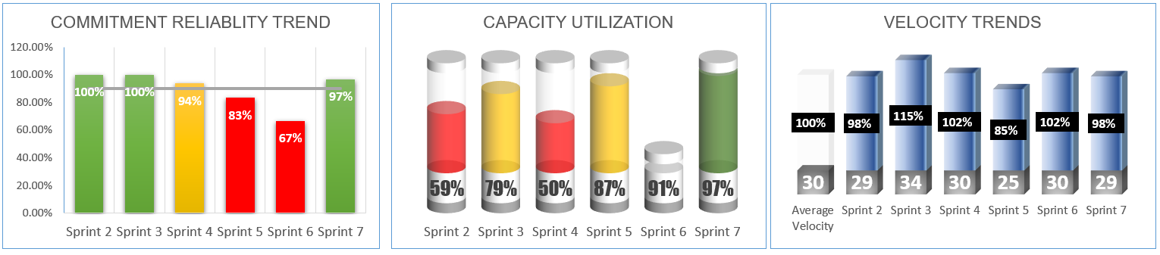
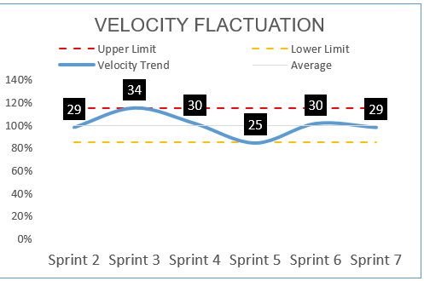
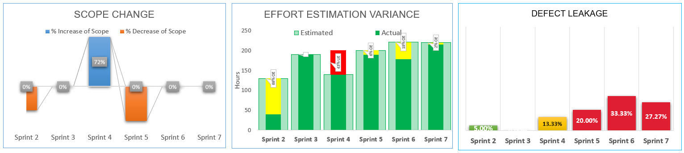
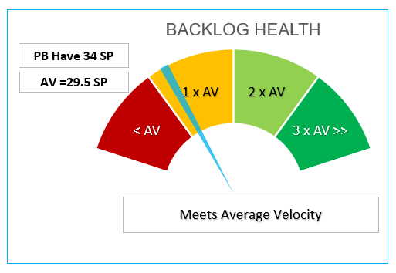
Frequently Used Metrics

Slide 3
Frequently Used Metrics
Commitment Reliability
Shows the percentage of story points completed against its commitment for every sprint. With Trend record among last 6 completed sprints.
Capacity Utilization
Represent the team capacity in hours and committed hours for each sprint, measured in effort hours. With Trends among last 6 sprints
Velocity
Represents total number of story points completed each sprint, with trend analysis for last 6 sprints.

Slide 4
Frequently Used Metrics
Velocity Fluctuation
Represents the velocity variance from average with relation to max and min tolerance.
Scope Change
Sprint over Sprint, for Last 6 sprint, amount of story points added to the sprint or amount of story points removed from the sprint, After Sprint Started.
Defect Leakage
Amount of Defects detected after development, You can calculate it as defects detected by development team Vs Defects detected by Product Owner / or UAT.

Slide 5
Frequently Used Metrics
Effort Estimation Variance
Effort estimated Vs Actual, shows Overestimation hours and under estimation hours
Scope Change
Sprint over Sprint, for Last 6 sprint, amount of story points added to the sprint or amount of story points removed from the sprint, After Sprint Started.
Backlog Health
Amount of Defects detected after development, You can calculate it as defects detected by development team Vs Defects detected by Product Owner / or UAT.

Slide 6
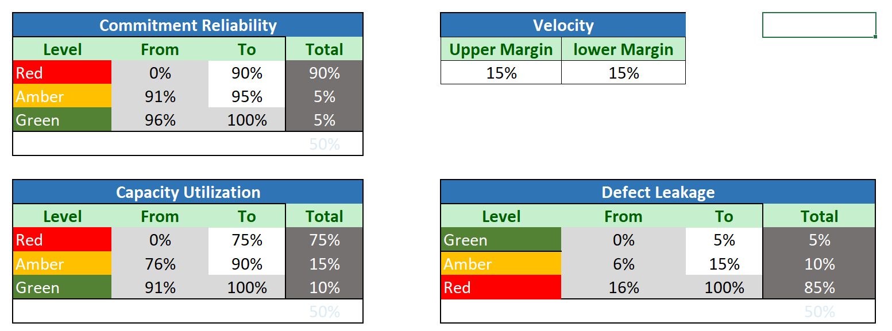
Defining the Maturity of Under Red, Amber Green (Sample)

Slide 7
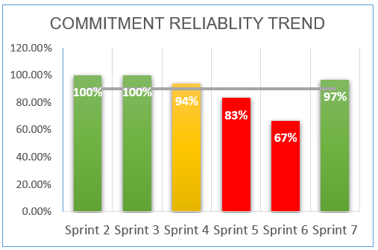

Slide 8
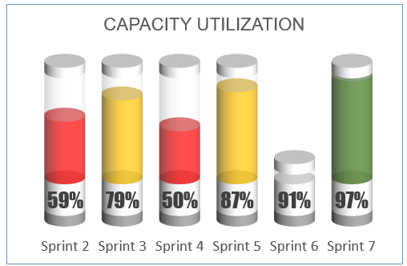

Slide 9
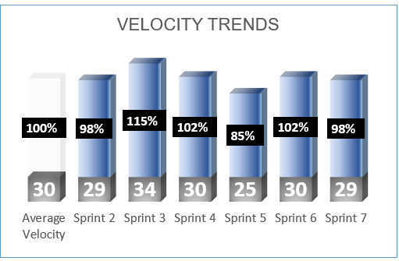
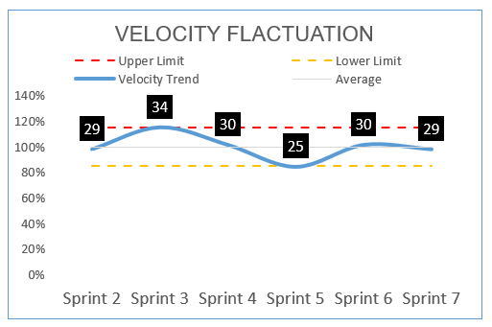
Velocity

Slide 10
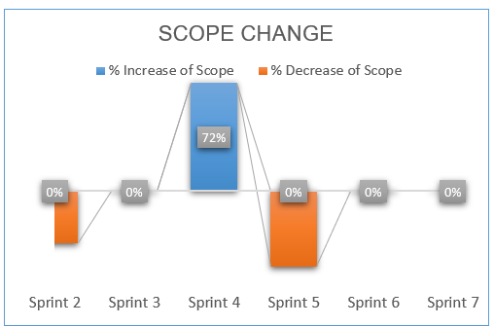
Scope Change

Slide 11
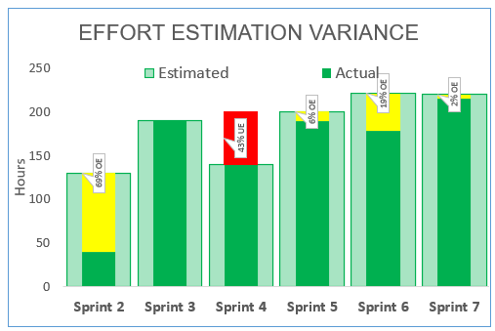
Estimation Varrience

Slide 12
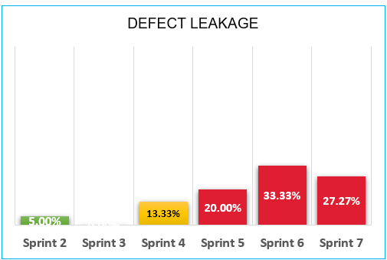
Defects Leakage

Slide 13
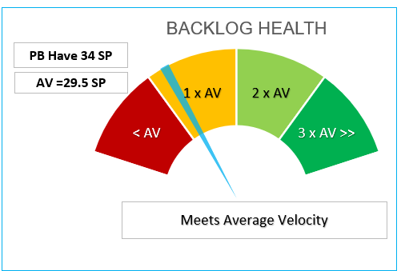

Slide 14
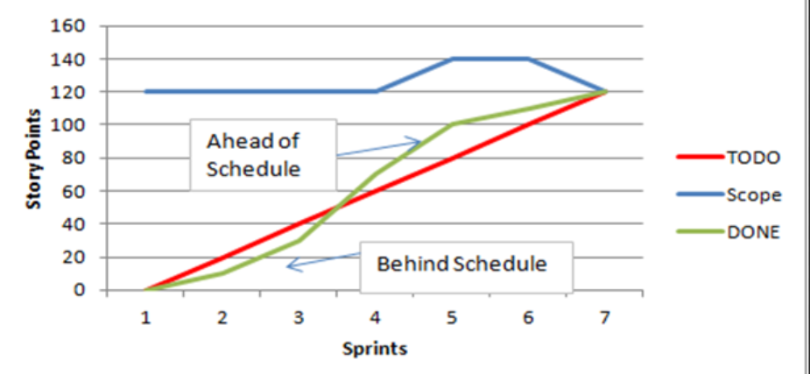
Burn Up Chart

Slide 15
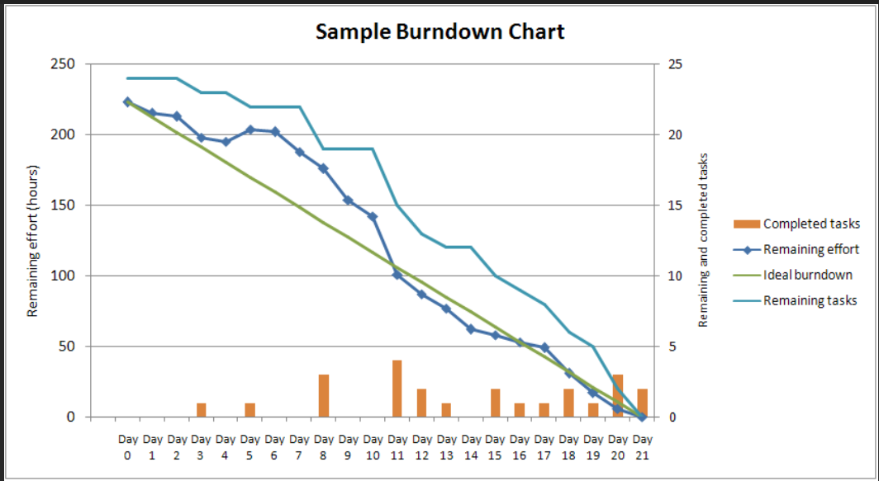
Burn Down Chart

